Slide 1
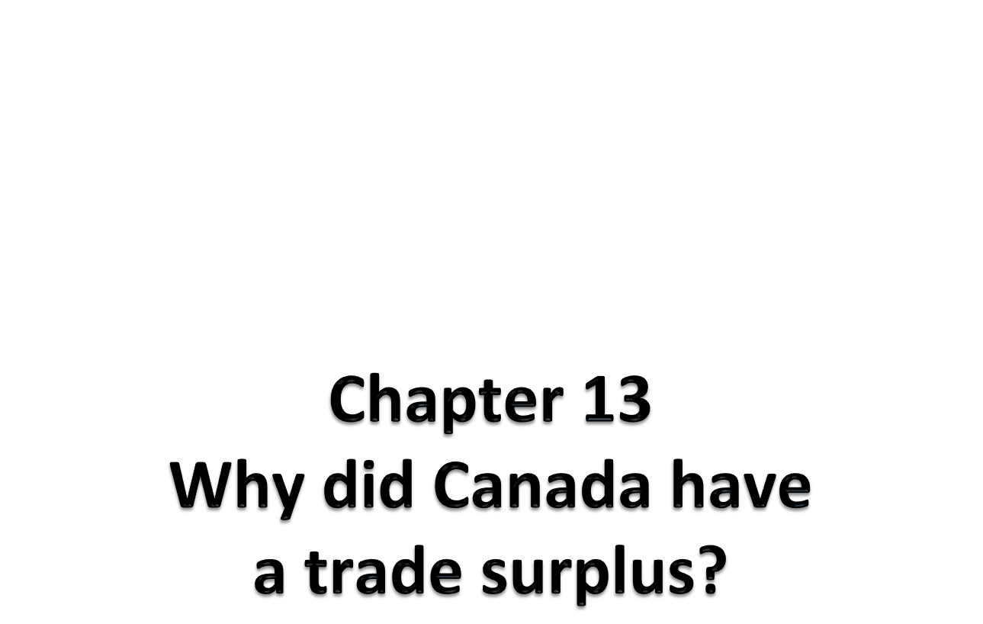
ECON 1BB3 – Introduction to Macroeconomics
Notes:
Next Friday is THE HARDEST LECTURE EVERRRR.
Extension of chapter 8.

Slide 2
Net exports
net exports (trade balance): exports – imports
exports: goods and services that are produced domestically and sold abroad
imports: goods and services that are produced abroad and sold domestically
Notes:
Trade surplus: exported more than imported
Spending by tourists → makes things trickier. Going to states and buy products = considered an import b/c it is produced by a foreign country and the spending is done by a Canadian.

Slide 3
What affects the trade balance?
factors affecting the trade balance:
1. tastes (foreign/domestic goods)
  2. prices (foreign/domestic)
  3. exchange rates
  4. income (foreign/domestic)
  5. transportation costs
  6. government trade policies
Notes:
1. Tastes for foreign goods (foreign country vs. another foreign country; foreign country vs. Canada)
2.
3. If going to go shopping in the US, need to change currency to US currency → impacts how much stuff you can buy
4. IF in Canada and domestic income increases = buy more stuff. When Canadian import goes up, Canadian trade balance goes down. Foreign income goes up, more people buy from Canada = more export = good for Canada’s trade balance.
This is why: what happens in the states is important to Canadian economy.
When domiestic income goes up, imports goes up (exorts doesn’t change) → bad for trade balance
→ When foreign income goes up , exports goes up (imports doesn’t change) → good for trade balance
5.
6. Tariffs
Which industry is largest in terms of Canada’s → industrial, then energy, and least is agricultural

Slide 4
Net capital outflow = Net Exports
net capital outflow (NCO): the purchase of foreign assets by domestic residents minus the purchase of domestic assets by foreign residents
net capital outflow is also called “net foreign investment” (NFI)
Notes:
Net foreign investment aka net capital outflow
FA (by domestic residents) – DA (by foreign residents)
Import – Export
NCO = NX (only way for NCO to increase is to increase imports through buying bonds/stocks forieng)
Examples of assets = stocks, bonds currencies (financial assets)
If American buy a share of RIM, example of DA (decrease NCO)
If Canadian buys Toyota, example of FA (increase NCO)

Slide 5
What affects NCO?
factors affecting net capital outflow include:
  1. real interest rate on domestic / foreign assets
  2. economic and political risk of holding assets abroad
  3. government policies affecting foreign ownership of domestic assets
Notes:
You buy a bond b/c you want to gain interest. If foreign assets pay a higher rate of interest, would rather by a foreign asset.
Stocks are riskier so you want a higher rate of return. Also have to think of political risk; political stability fosters more foreign investment.
Foreign ownership. Restrictions in foreign ownership have decrease. Governments often don’t want banks, defense industries, etc. to be dominated by foreign institutions. Telecommunications in Canada is highly [rotected

Slide 6
Types of foreign investment
foreign direct investment: a capital investment by domestic country that is owned and operated by a foreign entity
  Factory and store and hiring labour
foreign portfolio investment: an investment that is financed by a foreign entity, but operated by domestic residents
  Bonds and stocks
Notes:
Direct investment involves day-to-day control over decision making (i.e. decide how many cars to produce)
Portfolio:
Which of the following would be Canadian foreign direct investment?
a) Canadian canning factory opens a plant in Ecuador

Slide 7
Equality of NX and NCO
NCO = NX
why?
when a firm sells a good to a foreigner, the firm receives a good or an asset of equal value in return
if NX changes, NCO must also change
Notes:
Foreigner sells car to Canada and Canada sends 35k assets
Canadian import go up, net export go down by 35k
NCO (capital outflow goes down by 35k)
NX = ex – im (flow of goods)
NCO = im – ex (flow of capital or investment)
Trade surplus (NX >0) → capital flowing out of the country to buy foreign assets with the money earned from exports (NCO > 0 )
Trade deficiet (NX <0) → capital flowing into the country to sell foreign assets to get money to buy foreign goods (NCO < 0 )
Jap sells car to Bombardier
-NX goes down (we buy car)
-NCRO goes down (we give out CAN$)
Bombardier sells plane to Jap
-NX goes up (sell out plane)
-NCO goes up (receive yen)

Slide 8
Saving and investment in an open economy
Y = C + I + G + NX
Recall:
Y – C – G = S
Y – C – G = I + NX
S = I + NX
S – I = NX
NCO = NX
Notes:
S=I in closed economy
If Canadians don’t wana borrow our savings (S), we lend to foreign countries (I), → this is NX??
To get trade surplus, don’t cut I, increase S (public -> cut govt spending or raise tax)

Slide 9
since 1999, Canada has had NX > 0, therefore NCO > 0
national saving in Canada: 14% of GDP in 1993
22% of GDP in 2002
the increase in national saving has been mostly due to the provincial and federal governments eliminating deficits

Slide 10
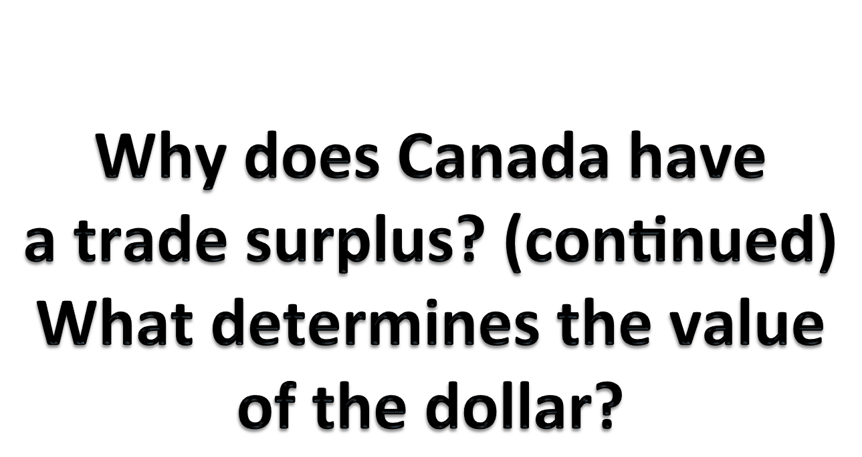
Notes:
$1 Can = $0.79US

Slide 11
Exchange rates
nominal exchange rate: the rate at which you can exchange currency for another (how much forex you can purchase with $1 CAD)
“e” – how much foreign currency you can purchase with $1 Canadian dollar (foreign currency per dollar)
the nominal exchange rate when $CAD appreciates
e goes up - $CAD appreciates (buys more foreign currency)
the nominal exchange rate when $CAD depreciates
e goes down - $CAD depreciates
Notes:
$1 Can = $0.79US
Rate at which you can denote currency. How many units of foreign currency per one unit of domestic currency?
Upward movement of E = appreciation, Canadian dollar buys more.
Appreciation

Slide 12
Is appreciation of $CAD good or bad?
a) good
b) bad
c) it depends

Slide 13
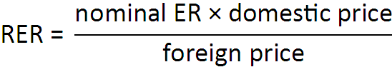

real exchange rate: the rate at which you can exchange goods & services between countries
the RER involves the nominal exchange rate and foreign & domestic prices
Notes:
*= denotes it being foreign

Slide 14
CLICKER
Notes:
Suppose that a bushel of wheat costs $4 in the US and costs 20 pesos in Mexico. If the nominal exchange rate is 10 pesos per dollar, the real exchange rate is
2
1
½
None of the above is correct.
Answer: A
Measured in what units?
2 US bushels of wheat per Mexican bushel of wheat
2 Mexican bushel of wheat per US bushel of wheat
Answer: B
eP/P* = 10 x 4/20 = 40 (cost in US)/20 (cost in Mexico)
2 Mexican bushel of wheat per US bushel of wheat
eP/P* = (10pesos/$ x $4/Usbushel)/[20pesos/Mex bushel]
TESTTTTTTTTTTTTTTTTTT (1 mark for the answer, 2 marks for the units)

Slide 15
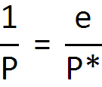
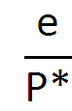
How are exchange rates determined?
purchasing-power parity (PPP): a unit of currency should buy the same quantity of goods in any country
quantity of goods a $CAD buys in Canada
quantity of goods a $CAD buys in a foreign country
Notes:
Face trade doesn’t always work. Canada stuff a lot cheaper than America OR vice versa.
Ppl will buy from where it is cheaper and sell it higher back home to equiliize the price
1/P = measures how much stuff I can buy in Canada (value of money → how much stuff I can buy in Canada).
-→ 1 CAN dollar is e US dollars
0.79US to go shopping in the states
How much stuff 1Can can buy in the states
What does the theory say about those two values → they should be the same

Slide 16

How are exchange rates determined?
We can rearrange this equation:
Notes:
Theory elegant in that there should be a way for someone to profit.
However, this theory does not work
If the puchasing power is the same in CAN and foreign, the RER cannot change
According to the theory of PPP, NER b/w two countruies must reflect the different price levels
Implication:
-NER change when price changes (tehrefore depend on money supply and demand)
-if central bank increases money supply, price increase, cause that countries’ currency to depreciate relative to other parts of the wordl
-therefore if central bank prints lots of money, the money loses its value
-as inflation rise, value of dollar fell
PPP says these two values should be EQUAL (ie. 1/P = e/P*; eP/P* = RER = 1)
This means that e = P*/P → so according to the PPP, nominal exchange rate between the currencies of two countries must reflect the different price levels in the countries and converting would still allow purchase of the same amount of a product →
so if central bank increases money supply, that money loses value both in terms of goods and services it can buy and in terms of amount of other currencies it can be exchanged for
Good thing about this theory is that it is easy to test; but when we look at countries, this usually isn’t true
Appreciation: exchange rates change so that CAN$ is worth more

Slide 17
How are exchange rates determined?
arbitrage: taking advantage of differences in prices in different markets AT THE SAME TIME to make a profit (not the same as a buying a stock hoping for a capital gain – this is called speculation)
PPP tends to “work” (explain movements in nominal exchange rates) in the long run or in countries with very different price levels
  Doesn’t work for short run
Notes:
Arbitrage: Process of buying low and selling high. Should be able to take advantage of price difference and make a profit.
Speculation is buying low now (it involves waiting a certain time period) and then someone buying higher.
PPP tends to work only in certain cases. PPP is not a bad predictor. Value of the Zimbabwean dollar has dropped so low. Huge differences in price levels between countries → then PPP tends to work. Because PPP says eP/P*.
eP/P*.
For Can and US, there isn’t much variation in e. E will change a lot when there is a huge variation in terms of price (fluctuation also known as “noise”); there will be a huge difference in terms of huge differences).
Services that need to be consumed locally.
___________
If p* is 85% and p is 2%, then e should go up (therefore, our CAN can buy a lot of that foreign currency which has dropped in value)
→huge change in p* cause movement of nominal ex rate in the way we expect it

Slide 18
Limitations of PPP
purchasing-power parity doesn’t always work because:
1. some goods are non-traded
-customer servce (drop in cost for transcommunications)
-haircut (need to be consumed locally)
2. traded goods are not perfect substitutes
-Mex beer is not the same as US beer (P won’t be equalized)
3. there are transportation costs
-if T cost too much, there won’t be big trade internationally
Notes:
******does #3 fall under #2?*******
Mexican beer is not the same as US beer not the same as Canadian beer
Big Mac Index → all mcdonalds should sell the same big mac in diff countries
→ See if PPP holds
Big Mac Index is a publication by the economist that has fantastic coverage of international topics
Eg. they will provide info like: McDonald’s Big Mac in many different countries (so P in America and P* in another country, and then if the actual P* is above the calculated P*, then it is labelled as over-valued, and if below then under-valued)
US dollar is much stronger recently due to the uncertainty in the world financial market, so people are using the US dollar as a safe currency to hold → this is a lot due to the earthquake / tsunami / expanding nuclear problem in Japan

Slide 19
Interest rates in a small open economy
small open economy (SOE): an economy that trades goods & services with other economies, and is not large enough to affect world interest rates or world prices
perfect capital mobility: full access to world financial markets
an example of an SOE with perfect capital mobility is Canada!
Notes:
Taking advantage of price difference at the same time/day = arbitrage → it makes exchange rate consistent among different countries

Slide 20

Interest rates in a small open economy
interest rate parity: in theory, the real interest rate (in Canada) should equal real interest in world financial markets
why?
Notes:
IRP = RIR on comparable assets should be the same in all economies with full access to world financila markets
Why?
With full accesss to worl market, savers would prefer to buy foreign assets that pay higher interest rates and Canadian savers would sell their assets. This forces Canadian borrows to offer a more attractive interest rate.
Same for borrowers who want to borrow at lower interest rate

Slide 21
Interest rates in a small open economy
r
S^{w}
D^{w}
World market for loanable funds
Q of LF

Slide 22
Interest rates in a small open economy
interest rate parity is not always perfect for two reasons:
1. risk
2. tax treatment
Notes:
Default = seller promises to repay the vuyer in the future, the possibility exists of the sller not doing so
Buyers (savers) of assets incur a default risk
-the higher the risk, the higher the IR asset that the buyers demand from the sellers (borrowers)
If some sellers are perceived to more likely default, the IR may differ and may not represent arbitrage opportunity
2) Assets in diff countries are not perfect substitutes
-govt may rax the returns earned on assets differently in diff countries
-similar assets may pay the same pre-tax return, but they may have diff after-tax returns
Those seeking arbitrage, look only at after-tax returns

